Slide 1
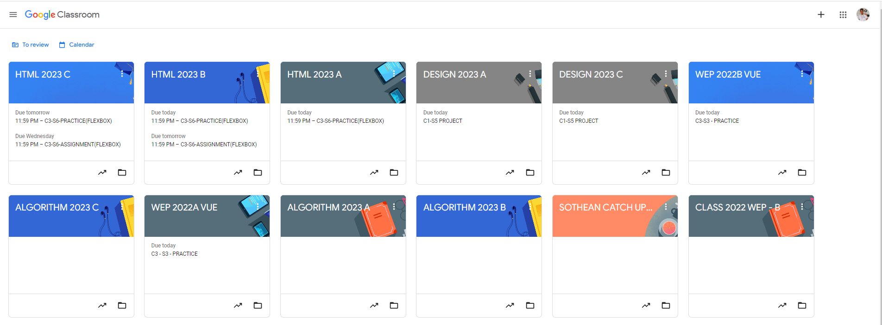
Identify root components of website below

Slide 2
Root: height : 100vh
Flex:0 nav
Flex:0 Header
Content
Flex: 1

Slide 3
Menu Or Navigation
Flex 1
Flex 1
Nav-left
Nav-right
icon
title
icon
icon
icon
Flex-direction: flex-start
Flex-direction: flex-end

Slide 4
header
div
div
div
icon
title
icon
title
icon
title
Flex-direction: row
Justify-content: flex-start

Slide 5
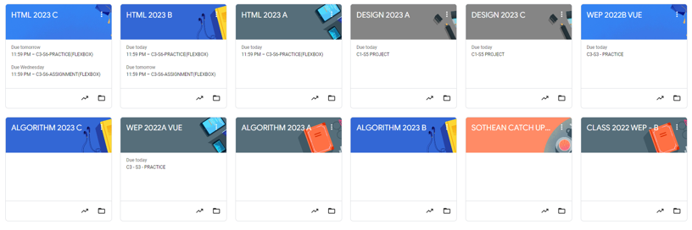
main​ or container
Flex-direction: row
Justify-content: flex-start
Flex-wrap : wrap
card1
card2
card3
card4
card5
card6
card7
card8
card9
card10
card11
card12

Slide 6
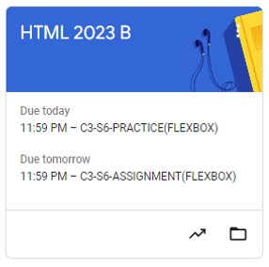
Card
Flex-direction: column;
Card-header
Flex:1.5
Card-body
Flex:2
Card-footer
Flex:1

Slide 7
Card
Card-title
icon
Card-content
Card-content
icon
icon

